Slide 1

GRAPH THEORY, APPLICATIONS AND COMBINATORICS
Surabhi Narayan
Department of Computer Science & Engineering

Slide 2

GRAPH THEORY, APPLICATIONS AND COMBINATORICS
HAMILTON GRAPHS
Surabhi Narayan
Department of Computer Science & Engineering

Slide 3
Graph Theory, Applications and Combinatorics
Hamilton Graphs
If G=(V,E) is a graph or multigraph with n>=3, we say that G has a Hamilton cycle if there is a cycle in G that contains every vertex in V.
A Hamilton path is a path in G that contains every vertex in the Graph G.
A Graph that contains a Hamilton cycle is called a Hamilton Graph or Hamiltonian Graph.
Length of Hamilton cycle in a connected graph is n and length of Hamilton path is n-1.
A
B
ABCDA is a Hamilton cycle
C
D

Slide 4
Graph Theory, Applications and Combinatorics
Hamilton Graphs
Dirac’s theorem
If in a simple connected graph with n vertices n>=3, the degree of every vertex is >=n/2 then the graph is Hamiltonian.
Proof:

Slide 6
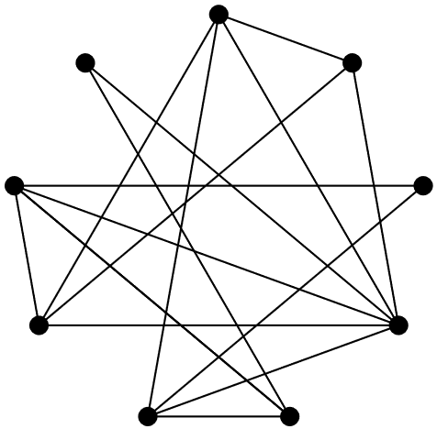
Graph Theory, Applications and Combinatorics
Hamilton Graphs
Below is a graph representing friendships between a group of students (each vertex is a student and each edge is a friendship). Is it possible for the students to sit around a round table in such a way that every student sits between two of their friends? What does this question have to do with paths?
The path {1, 2, 4, 9, 5, 6, 3, 8, 7, 1 } is a Hamilton cycle.

Slide 7
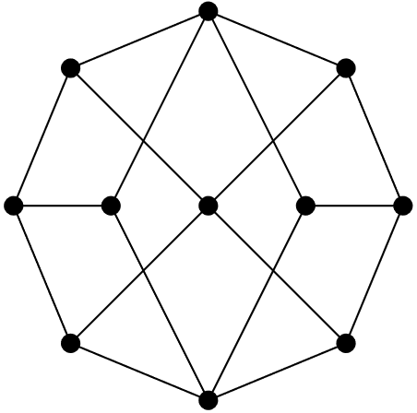
Graph Theory, Applications and Combinatorics
Hamilton Graphs
Consider the following graph:
Find a Hamilton path. Can your path be extended to a Hamilton cycle?
Is the graph bipartite? If so, how many vertices are in each “part”?
Use your answer to part (b) to prove that the graph has no Hamilton cycle.

Slide 8
Graph Theory, Applications and Combinatorics
Hamilton Graphs
1
Consider the following graph:
8
2
7
3
9
10
11
6
5
4
Find a Hamilton path. Can your path be extended to a Hamilton cycle?
There are many correct answers for a Hamilton path on this graph. If we label each vertex like this:
An example of one Hamilton path on this graph is {2, 1, 11, 3, 4, 10, 8, 7, 9, 5, 6}. This path cannot be extended to a Hamilton cycle.

Slide 9
Graph Theory, Applications and Combinatorics
Hamilton Graphs
1
Consider the following graph:
8
2
7
3
9
10
11
4
6
5
Is the graph bipartite? If so, how many vertices are in each “part”?
Yes, the graph is bipartite:
V1 ={1, 3, 5, 7, 10} and V2 ={2, 4, 6, 8, 9, 11}. There are 5 and 6 vertices in each part

Slide 10
Graph Theory, Applications and Combinatorics
Hamilton Graphs
1
Consider the following graph:
8
2
7
3
9
10
11
4
6
5
Use your answer to part (b) to prove that the graph has no Hamilton cycle.
We know that any bipartite graph that has a Hamiltonian cycle must have the same number of vertices in V1 and V2, otherwise it will be impossible to create a cycle that alternates between vertices in V1 and V2 that starts and ends at the same vertex. We have |V1| = 5 |V2| = 6, so we know there can’t be a Hamilton cycle in this graph.

Slide 11
Graph Theory, Applications and Combinatorics
Hamilton Graphs
For which n does Kn contain a Hamilton path? A Hamilton cycle? Explain.
All values of n. In particular, Kn contains Cn as a subgroup, which is a cycle that includes every vertex.

Slide 12
Graph Theory, Applications and Combinatorics
Hamilton Graphs
For which m and n does the graph Km,n contain a Hamilton path? A Hamilton cycle? Explain.
As long as |m−n|≤1, the graph Km,n will have a Hamilton path. To have a Hamilton cycle, we must have m=n.

Slide 13
Graph Theory, Applications and Combinatorics
Hamilton Graphs
Prove that the complete graph kn where n>=3 is a Hamilton graph
Solution: In K_{n}, the degree of every vertex is n-1 if n>=3 , we have n-2 greater than 0
n-2 > 0
n + n -2 > 0 + n
2n -2 > n
2(n-1) > n
(n-1) > n/2
Thus in K_{n} the degree of every vertex is >=2. therefore by Dirac’s theorem K_{n} is Hamiltonian.

Slide 14
Graph Theory, Applications and Combinatorics
Hamilton Graphs
The complete bipartite graph Km,n is Hamiltonian iff m=n >=2
Part 1: Km,n is a complete bipartite graph with m=n >=2
To prove: Km,n is Hamiltonian
Consider Km,n where m=n >=2
Let the partites be X={x1, x2, …. xm} and Y= {y1, y2, ….yn}
Consider the cycle {x1,y1,x2,y2…..xm,yn,x1}. This consists of all vertices in the bipartite graph. Hence is a Hamilton cycle.

Slide 15
Graph Theory, Applications and Combinatorics
Hamilton Graphs
The complete bipartite graph Km,n is Hamiltonian iff m=n >=2
Part 2: Let Km,n complete bipartite and Hamiltonian
To prove: m=n >= 2
By definition, the graph has Hamilton cycle.
The graph has atleast 3 vertices. Hence m>=2 or n>=2
Let the partites be X={x1,…xm} and Y={y1,y2,…yn}
The Hamilton cycle C= {v1, v2,……vm+n,v1}
If we remove v1 the cycle becomes a path P= {v1,v2,……vm+n}
vm+n has to belong to Y as v1 belongs to X
Implies that m=n

Slide 16
Graph Theory, Applications and Combinatorics
Hamilton Graphs
Show that the number of Hamilton cycles in a complete bipartite graph kn,n is ½(n-1)!n! for (n>=2)
How many different Hamilton paths are there in kn,n?
Proof: Let X and Y be the bipartites of kn,n with X={x1, x2, … xn} and Y= {y1, y2, …yn}
i) Then each edge of kn,n is of the form (xi,yj) where i,j = 1,2, …n
Start with x1. There are n choices of yj. There are n-1 choices from xi
Total number of cycles is ½(n-1)!n!
ii) Every Hamilton path is kn,n starts in either X or Y and terminates in the other. The number of such paths is (n!)(n!)

Slide 17
THANK YOU
Surabhi Narayan
Department of Computer Science &Engineering
surabhinarayan@pes.edu

